Slide 1
FreeRTOS Course (Day 4)
By Mahmoud Elsheemy

Slide 2
Intertask Communication
How Tasks can talk to each other ?
Tasks can communicate through Buffers, Message box, Queues, Shared memory, … etc.
Semaphores are part of Intertask communication
Task 1
?
Task 2

Slide 3
Queue in FreeRTOS
Create Queue
QueueHandle_t xQueueCreate( UBaseType_t uxQueueLength, UBaseType_t uxItemSize );
Send element to Queue
BaseType_t xQueueSend( QueueHandle_t xQueue, const void * pvItemToQueue, TickType_t xTicksToWait );
Receive element from Queue
BaseType_t xQueueReceive( QueueHandle_t xQueue, void *pvBuffer, TickType_t xTicksToWait );

Slide 4
Let’s do some coding

Slide 5
Mutexes in FreeRTOS
Mutexes are binary semaphores that include a priority inheritance mechanism.
Create Mutex in FreeRTOS:
SemaphoreHandle_t xSemaphoreCreateMutex( void );
What is priority inheritance ?

Slide 6
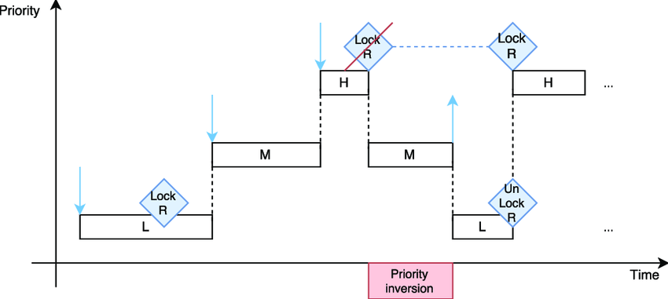
The problem of priority inversion

Slide 7
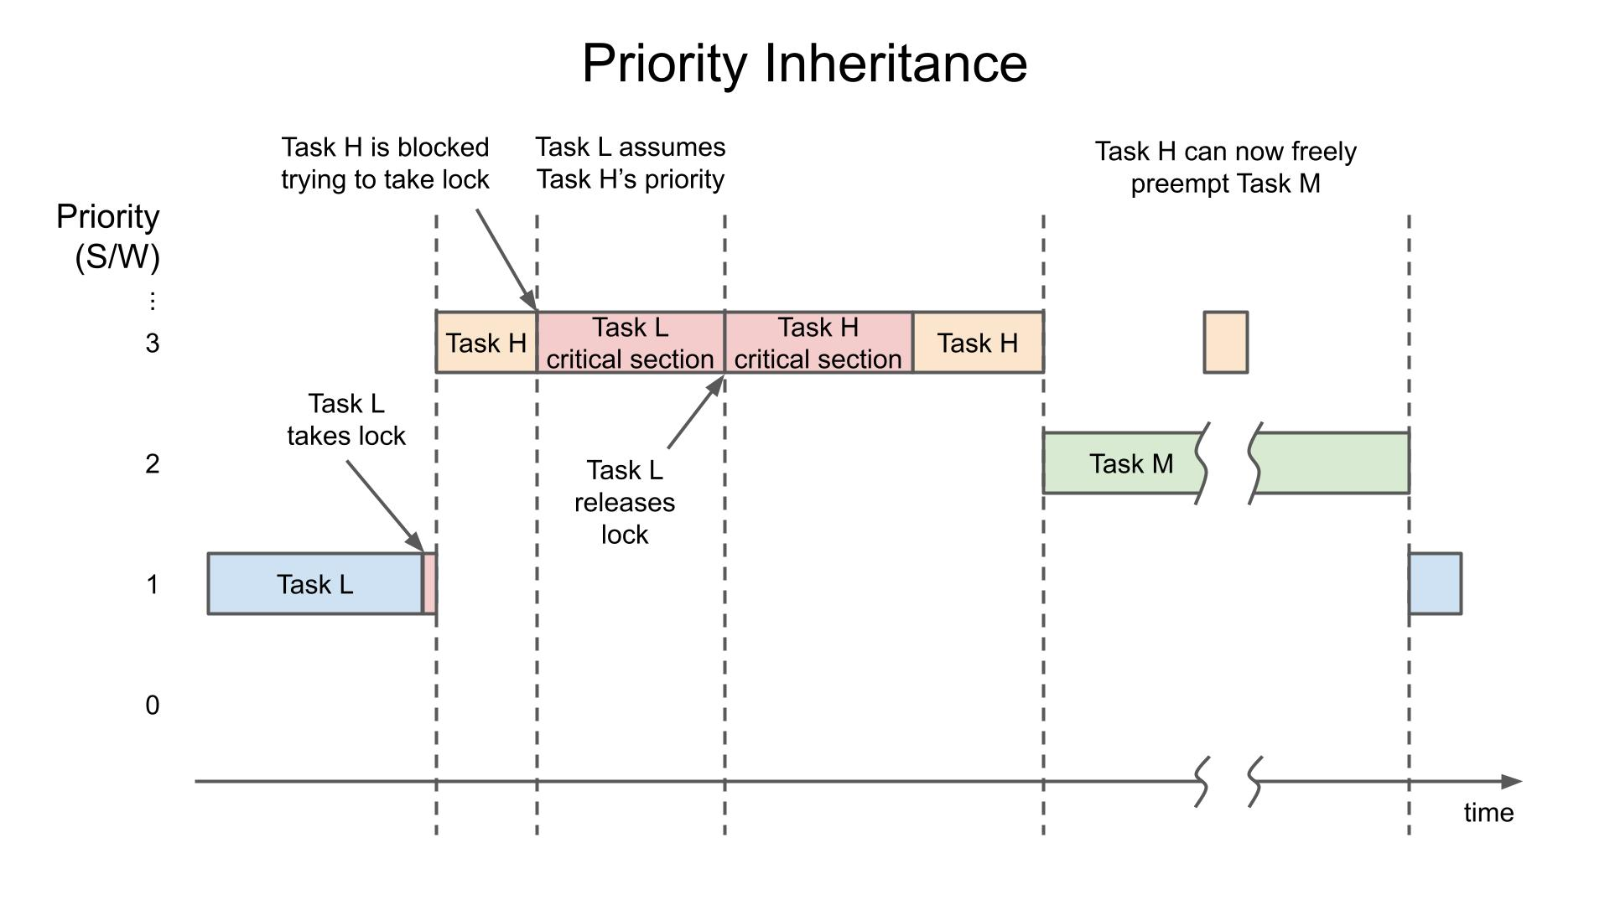
Priority inheritance

Slide 8
Suspend and Resume
Suspend a task
void vTaskSuspend( TaskHandle_t pxTaskToSuspend );
Resume a suspended task
void vTaskResume( TaskHandle_t pxTaskToResume );
Example:
Car in R mode
Car in P mode
Suspend R Mode Tasks, Resume P mode Tasks
Suspend P Mode Tasks, Resume R mode Tasks
Check reverse gear
Check safety transmission
Signal backlights
Check gear locking
Disable accelometer
Disable transformer

Slide 9
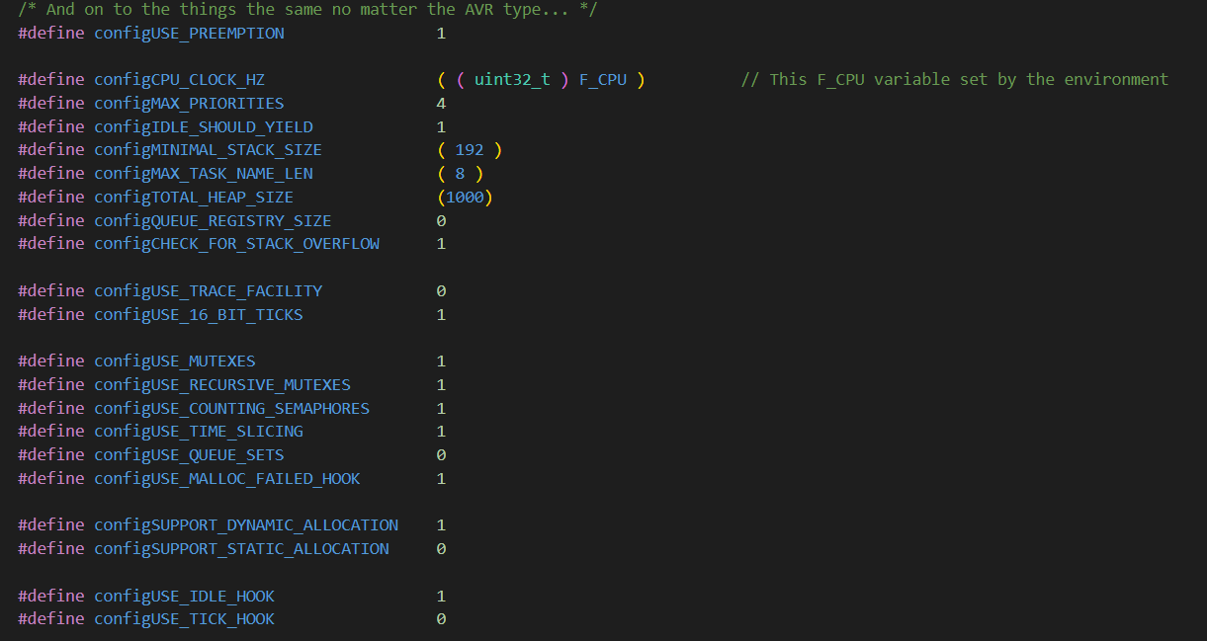
FreeRTOS config file

Slide 10

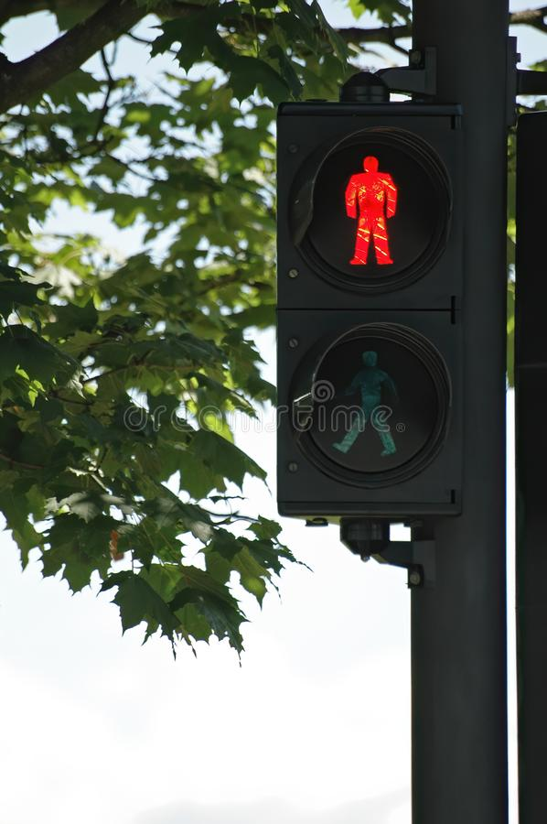
Final Project
Traffic Light with Walk and don’t walk sign

